Slide 1
Serverless Applications with AWS
Norm Johanson, Senior Software Engineer at AWS

Slide 2
Goals for Today
How to use .NET Core 2.0 and AWS Lambda
Learn how to build an AWS Serverless Application
Talk about CI/CD for Serverless .NET Core

Slide 3
AWS Lambda

Slide 4
AWS Lambda
Fully managed compute environment
Provides on-demand compute capacity very quickly
300 second max execution duration per request
Event Based
HTTP Events (via Amazon API Gateway)
Service Events (i.e. Amazon S3 and Amazon DynamoDB)
Custom Events (Invoked by the any of the AWS SDKs)
Billing based on function execution time
No charges for idle functions

Slide 5

How Does Lambda Work? (10,000 foot view)
First event
New compute environment (C1)
Cold start
Processes event
C1 freezes
Second event
Warm start
C1 thaws and process event
C1 freezes
2 events come in
1 event reuses C1
2 second event creates C2
C1 and C2 freeze
C1 and C2 are removed after a period of inactivity

Slide 6
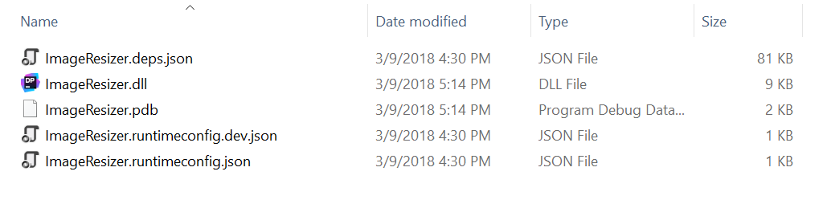
What is a .NET Core Lambda Function
.NET Core 2.0 project (targeting netcoreapp2.0)
Packaged using dotnet publish
Highly recommend using an AWS tool to create the package
AWS Toolkit for Visual Studio
Amazon.Lambda.Tools – Extension to the dotnet CLI

Slide 7
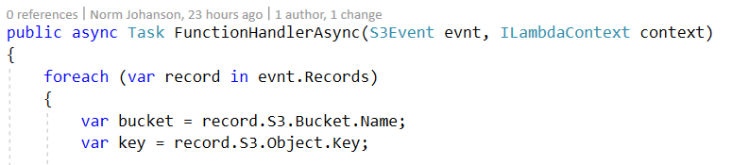
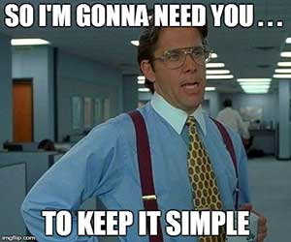
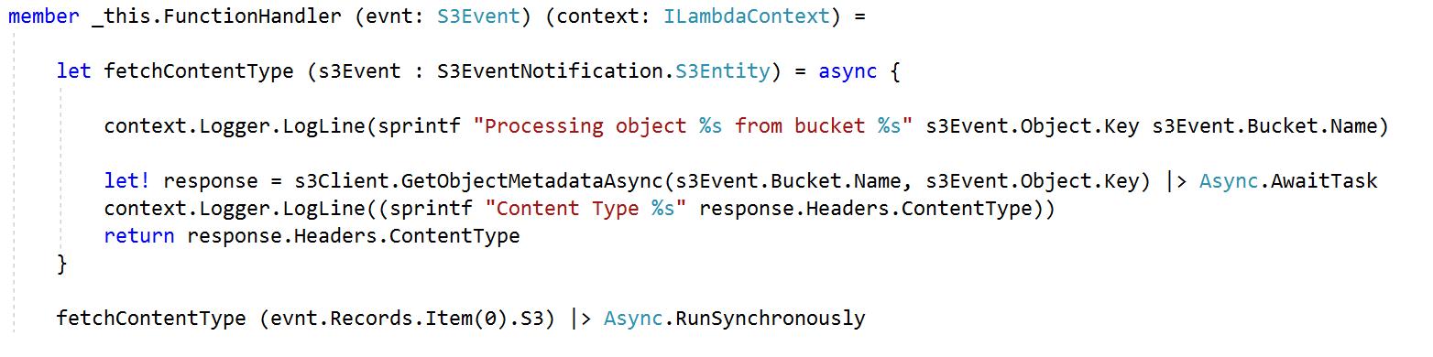
Coding a .NET Core Lambda Function
Identified by the function handler string
<assembly>::<full type name>::<method>

Slide 8
Demo Time

Slide 9
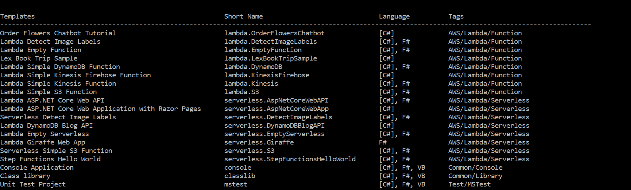
Creating Lambda Projects from the dotnet CLI
Install: dotnet new -i Amazon.Lambda.Templates
New Project: dotnet new lambda.EmptyFunction --region us-east-1

Slide 10
What is a Serverless Application?

Slide 11
Anatomy of AWS Serverless Application
Compute
AWS Lambda
Storage
Amazon S3 (Object Storage)
Amazon DynamoDB (NoSQL)
Communication
Amazon Simple Queue Service (Queues)
Amazon Simple Notification Service (Topics)
Service Events
Workflow
AWS Step Functions

Slide 12
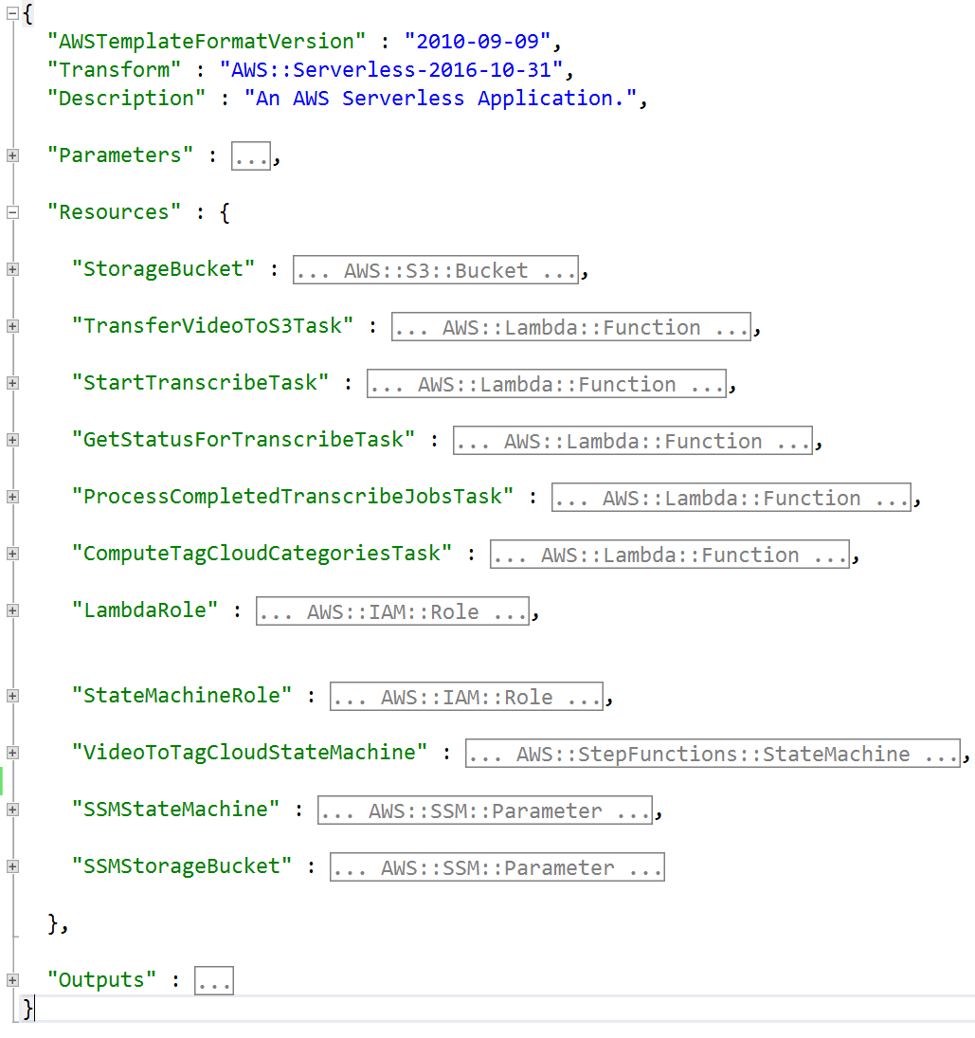
Deploying with AWS CloudFormation
Provisions Resources
Write Template File
JSON or YAML
Deployed template is a Stack
Creates and Deletes resources as a unit.

Slide 13

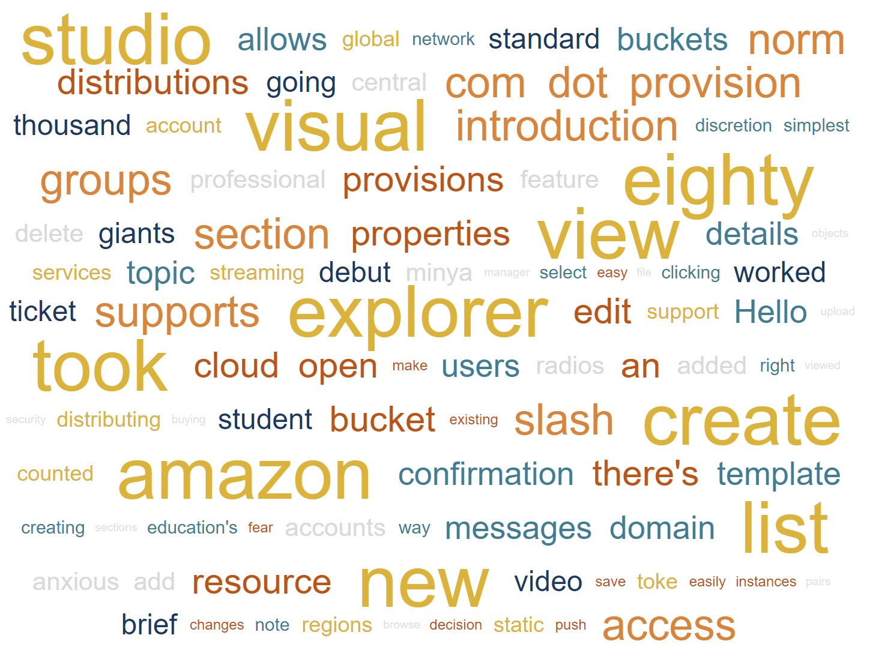
Video Tag Cloud Generator
MP4 Video

Slide 14
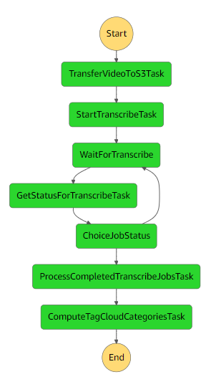
AWS Step Functions State Machine
Copy the Video to S3 application bucket
Start Transcribe Job
Wait for job to complete
Copy transcript to S3 application bucket
Process transcript for frequent words

Slide 15
Demo Time

Slide 16
Exposing a REST API
Amazon API Gateway
GET - /api/TagClouds
GET - /api/TagClouds/{id}
POST - /api/TagClouds
Targets
Lambda Function
EC2 Instance
Load Balancer
S3 Bucket
HTTP endpoint

Slide 17
ASP.NET Core in Lambda
Use a common framework and the extensions/middleware that come with it
Makes local development easy
Package size reduced with package store
Microsoft.AspNetCore.All – meta NuGet package
Amazon.Lambda.AspNetCoreServer NuGet package
Converts requests and responses between Amazon API Gateway and ASP.NET Core Framework.

Slide 18
Demo Time

Slide 19
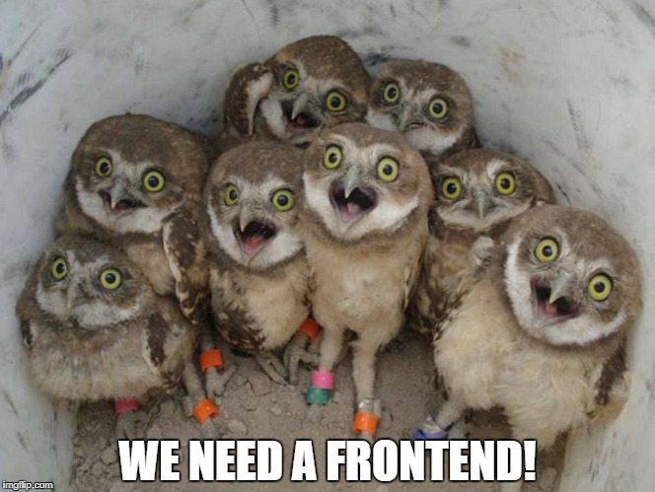

Slide 20
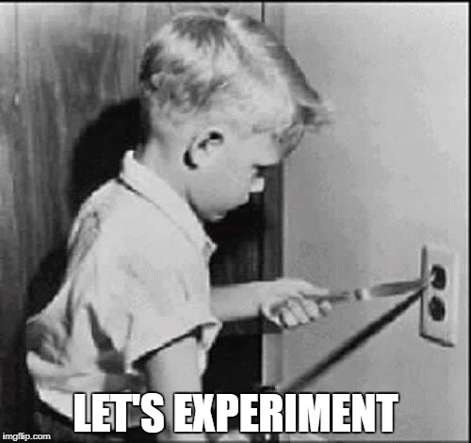
What is Blazor?
Microsoft experimental .NET web framework with WebAssembly.
Run C# and Razor in the browser
Interop with the DOM and Javascript
Standards based
Not another Silverlight
Early Days
Current version 0.3
No debugging yet in Visual Studio

Slide 21
What does Blazor have to do with Serverless?
No compute power needed
Compute provided by the user’s browser
Host the Blazor application in Amazon S3
Make REST call to our ASP.NET Core Web API

Slide 22
Demo Time

Slide 23
Continuous Integrations & Continuous Delivery

Slide 24
AWS Code Services
AWS CodeCommit
Git source control provider
AWS CodeBuild
Docker based build system
AWS CodePipeline
CI/CD service to connect your source, build and deployment together.
Supports third party source providers, like GitHub, and build systems like Jenkins.

Slide 25





CI - Serverless
AWS CodePipeline
AWS CodeCommit
AWS CodeBuild
AWS CloudFormation
.NET Core Project
CloudFormation Template
CloudFormation templated with
updated package location
dotnet lambda package-ci
Create change set
Execute change set
Source Stage
Build Stage
Lambda Package Bundle
Deploy Stage
Amazon S3
Lambda function

Slide 26






AWS Tools for Visual Studio Team Services
Tasks for deployment:
AWS CodeDeploy
AWS CloudFormation
AWS Elastic Beanstalk
AWS Lambda
AWS CodeDeploy
AWS CloudFormation
AWS Elastic Beanstalk
AWS
Lambda
General purpose tasks:
Amazon S3 uploads/downloads
Invoking Lambda functions
Send SNS messages
Run cmdlets/scripts using the AWS PowerShell Tools Module
Run AWS CLI commands
Amazon S3
Amazon SNS
AWS
CLI
AWS Tools for
Windows PowerShell
https://github.com/aws/aws-vsts-tools
https://aws.amazon.com/vsts/

Slide 27
Demo Time

Slide 28
Recap
Learn how AWS Lambda Scales
How to build a .NET AWS Serverless application
Build Workflows with AWS Step Functions
Deploy with AWS CloudFormation
AWS Toolkit for Visual Studio
Or use dotnet CLI extensions
Amazon.Lambda.Tools
dotnet lambda deploy-serverless
Amazon.Lambda.Templates
dotnet new -i Amazon.Lambda.Tools
CI/CD options for deploying to AWS

Slide 29
Thank You!
Norm Johanson
Twitter: @socketnorm
AWS .NET Developer Blog: https://aws.amazon.com/blogs/developer/category/net/
Conference Code: https://github.com/normj/NDCMinnesotaAWSServerless
GitHub Repos
AWS .NET Lambda Tools: https://github.com/aws/aws-lambda-dotnet
AWS Extensions for Dotnet CLI: https://github.com/aws/aws-extensions-for-dotnet-cli
AWS Tools for VSTS: https://github.com/aws/aws-vsts-tools
AWS SDK for .NET: https://github.com/aws/aws-sdk-net

